Slide 1



MUSIC DATABASE ANALYSIS
MUSIC DATABASE ANALYSIS
Insights on Sales, Customers, and Artists
SQL Queries & Business Insights

Slide 2


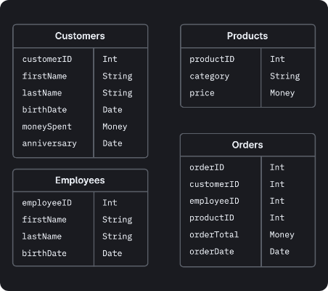
DATABASE SCHEMA STRUCTURE
The analysis is based on a relational database comprising 11 core tables that track store operations, sales, and music inventory.
Employee
Customer
Invoice
InvoiceLine
Track
Album
Artist
Genre
MediaType
Playlist
PlaylistTrack

Slide 3


SENIOR MOST EMPLOYEE
QUESTION
WHO IS THE SENIOR MOST EMPLOYEE BASED ON JOB TITLE?
SELECT
FROM
employee
ORDER BY
DESC
LIMIT

Slide 4




GLOBAL INVOICES SALES
QUESTION
Which countries have the most Invoices?
SELECT
count
as
FROM
invoice
GROUP BY
ORDER BY
DESC
HIGH VALUE INVOICES
What are the top 3 value of total invoice?
SELECT
FROM
invoice
ORDER BY
DESC LIMIT

Slide 5

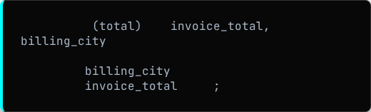
BEST CITY FESTIVAL
We plan to throw a promotional Music Festival in the city we made the most money.
SELECT
sum
as
FROM
invoice
GROUP BY
ORDER BY
DESC

Slide 6


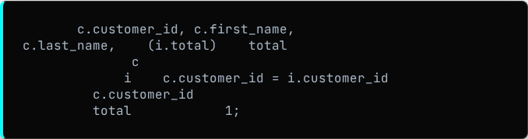
BEST CUSTOMER VIP
The customer who has spent the most money will be declared the best customer.
SELECT
sum
as
FROM
customer
JOIN
invoice
ON
GROUP BY
ORDER BY
DESC LIMIT

Slide 7


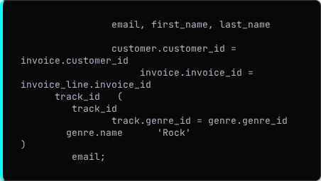
ROCK LISTENERS EMAIL LIST
Return email, name, & Genre of all Rock Music listeners ordered alphabetically.
SELECT DISTINCT
FROM
customer
JOIN
invoice
ON
JOIN
invoice_line
ON
WHERE
IN
SELECT
FROM
track
JOIN
genre
ON
WHERE
LIKE
ORDER BY

Slide 8

TOP BANDS INVENTORY
Return the Artist name and total track count of the top 10 rock bands.
SELECT t1.first_name, t1.last_name, t3.name AS bsa_name,
SUM(t4.unit_price * t4.quantity) AS amount_spent
FROM customer t1
INNER JOIN
invoice t2 ON t1.customer_id = t2.customer_id
INNER JOIN
invoice_line t4 ON t2.invoice_id = t4.invoice_id
INNER JOIN
track t5 ON t4.track_id = t5.track_id
INNER JOIN
album t6 ON t5.album_id = t6.album_id
INNER JOIN
best_selling_artist t3 ON t6.artist_id = t3.artist_id
GROUP BY
t1.customer_id, t1.first_name, t1.last_name, t3.name
ORDER BY
amount_spent DESC;
SELECT
COUNT
AS
FROM
track
JOIN
album
ON
JOIN
artist
ON
JOIN
genre
ON
WHERE
LIKE
GROUP BY
ORDER BY
DESC LIMIT

Slide 9


LONG TRACKS ANALYSIS
ABOVE AVERAGE DURATION
Return all track names that have a song length longer than the average song length.
SELECT
FROM
track
WHERE
SELECT AVG
FROM
track
ORDER BY
DESC

Slide 10

ARTIST SPEND PER CUSTOMER
Find how much amount spent by each customer on artists.
WITH best_selling_artist AS ( SELECT t2.artist_id,
SUM(t4.unit_price * t4.quantity) AS sales
FROM
invoice t1
INNER JOIN
invoice_line t4 ON t1.invoice_id = t4.invoice_id
INNER JOIN
track t3 ON t4.track_id = t3.track_id
INNER JOIN
album t5 ON t3.album_id = t5.album_id
INNER JOIN
artist t2 ON t5.artist_id = t2.artist_id
GROUP BY
t2.artist_id
ORDER BY
sales DESC
LIMIT 1
)
SM
AS
FROM
invoice_line
JOIN
track
ON
JOIN
album
ON
JOIN
artist
ON
GROUP BY
ORDER BY
DESC LIMIT
SELECT
SUM
AS
FROM
invoice
JOIN
customer
ON
JOIN
invoice_line
ON
JOIN
track
ON
JOIN
album
ON
JOIN
ON
GROUP BY
ORDER BY
DESC

Slide 11

POPULAR GENRE BY COUNTRY
We determine the most popular genre as the genre with the highest amount of purchases for each country.
AS (
SELECT COUNT(t1.quantity) AS purchases, t3.country, t5.name AS g_name, ROW_NUMBER() OVER(PARTITION BY t3.country ORDER BY COUNT(t1.quantity) DESC) AS RowNo
FROM invoice_line t1
INNER JOIN
invoice t2 ON t2.invoice_id = t1.invoice_id
INNER JOIN
customer t3 ON t3.customer_id = t2.customer_id
INNER JOIN
track t4 ON t4.track_id = t1.track_id
INNER JOIN
genre t5 ON t5.genre_id = t4.genre_id
GROUP BY t3.country,
t5.name -- t3.country t5.name (g_name) Grouping
ORDER BY t3.country, purchases DESC)
SELECT * FROM popular_genre
WHERE RowNo <= 1;
WITH
AS
SELECT
COUNT
AS
ROW_NUMBER
OVER
PARTITION BY
ORDER BY
COUNT
DESC
AS
FROM
invoice_line
JOIN
invoice
ON
JOIN
customer
ON
JOIN
track
ON
JOIN
genre
ON
GROUP BY
ORDER BY
ASC
DESC
SELECT
FROM
WHERE

Slide 12

TOP SPENDER BY COUNTRY
Determines the customer that has spent the most on music for each country.
WITH Customer_with_country AS ( SELECT c.customer_id, c.first_name,
i.billing_country, SUM(i.total) AS total_spending,
ROW_NUMBER() OVER(PARTITION BY i.billing_country ORDER BY SUM(i.total) DESC) AS RowNo
FROM invoice i
INNER JOIN
customer c ON c.customer_id = i.customer_id
GROUP BY c.customer_id, c.first_name, i.billing_country
ORDER BY
total_spending DESC,
billing_country
)
SELECT * FROM Customer_with_country
WHERE RowNo <= 1;
WITH
AS
SELECT
SUM
AS
ROW_NUMBER
OVER
PARTITION BY
ORDER BY
SUM
DESC
AS
FROM
invoice
JOIN
customer
ON
GROUP BY
ORDER BY
ASC
DESC
SELECT
FROM
WHERE

Slide 13

THANK YOU!
Your data-driven journey through the music industry.
~ Vanshika Dubey

